Slide 1

CHAPTER 10
THEORY OF GRAPHS AND TREES
Copyright © Cengage Learning. All rights reserved.

Slide 2

10.4
Trees: Examples and Basic Properties
Copyright © Cengage Learning. All rights reserved.

Slide 3
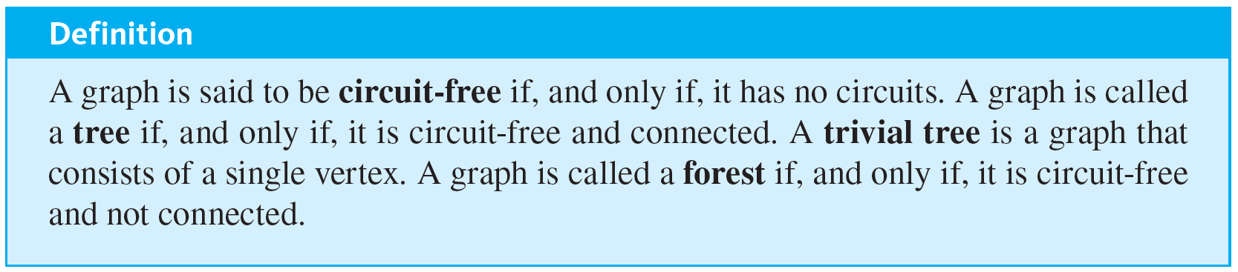
Trees: Examples and Basic Properties
In mathematics, a tree is a connected graph that does not contain any circuits. Mathematical trees are similar in certain ways to their botanical namesakes.

Slide 4
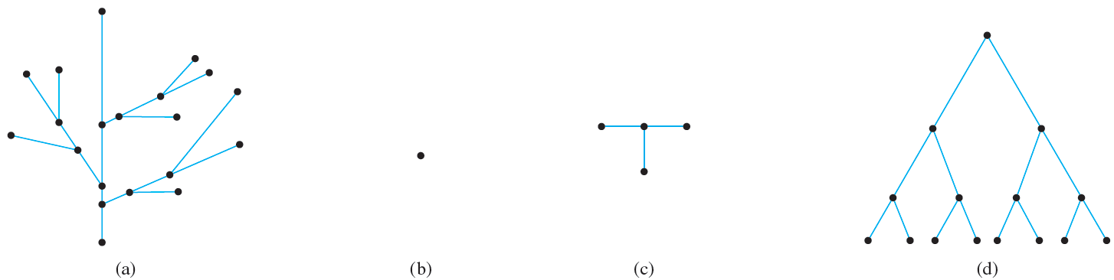
Example 10.4.1 – Trees and Non-trees
All the graphs shown in Figure 10.4.1 are trees, whereas those in Figure 10.4.2 are not.
Trees. All the graphs in (a)–(d) are connected and circuit-free.
Figure 10.4.1

Slide 5
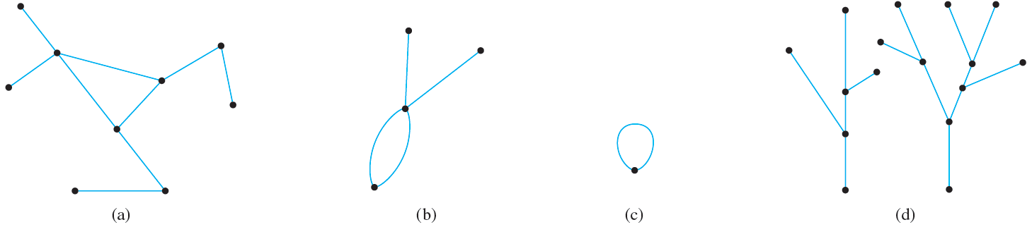
Example 10.4.1 – Trees and Non-trees
continued
Non-trees. The graphs in (a), (b), and (c) all have circuits, and the graph in (d) is not connected.
Figure 10.4.2

Slide 6
Examples of Trees

Slide 7
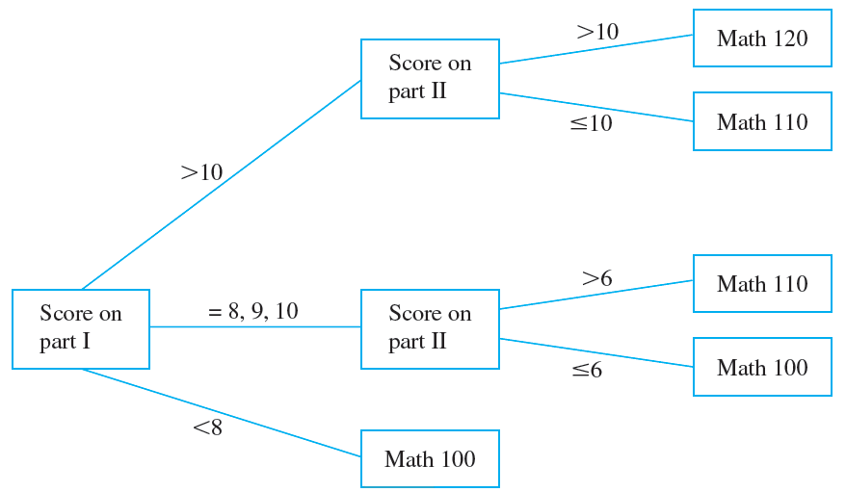
Example 10.4.2 – A Decision Tree
During orientation week, a college administers a mathematics placement exam to all entering students. The exam consists of two parts, and placement recommendations are made as indicated by the tree shown in Figure 10.4.3.
Figure 10.4.3

Slide 8
Example 10.4.2 – A Decision Tree
continued
Read the tree from left to right to decide what course should be recommended for a student who scored 9 on part I and 7 on part II.

Slide 9
Example 10.4.2 – Solution
Since the student scored 9 on part I, the score on part II is checked.
Since it is greater than 6, the student should be advised to take Math 110.

Slide 10
Example 10.4.3 – A Parse Tree
In the last 30 years, Noam Chomsky and others have developed new ways to describe the syntax (or grammatical structure) of natural languages such as English.
In the study of grammars, trees are often used to show the derivation of grammatically correct sentences from certain basic rules. Such trees are called syntactic derivation trees or parse trees.

Slide 11
Example 10.4.3 – A Parse Tree
continued
A very small subset of English grammar, for example, specifies that
1. a sentence can be produced by writing first a noun phrase and then a verb phrase;
2. a noun phrase can be produced by writing an article and then a noun;
3. a noun phrase can also be produced by writing an article, then an adjective, and then a noun;
4. a verb phrase can be produced by writing a verb and then a noun phrase;

Slide 12
Example 10.4.3 – A Parse Tree
continued
5. one article is “the”;
6. one adjective is “young”;
7. one verb is “caught”;
8. one noun is “man”;
9. one (other) noun is “ball.”
The rules of a grammar are called productions. It is customary to express them using the shorthand notation illustrated on the next slide.

Slide 13
Example 10.4.3 – A Parse Tree
continued
This notation, introduced by John Backus in 1959 and modified by Peter Naur in 1960, was used to describe the computer language Algol and is called the Backus–Naur notation.
In the notation, the symbol
represents the word or, and angle brackets 〈 〉 are used to enclose terms to be defined (such as a sentence or noun phrase).
1. 〈sentence〉 → 〈noun phrase〉 〈verb phrase〉
2., 3. 〈noun phrase〉 → 〈article〉 〈noun〉
〈article〉 〈adjective〉 〈noun〉

Slide 14
Example 10.4.3 – A Parse Tree
continued
4. 〈verb phrase〉 → 〈verb〉 〈noun phrase〉
5. 〈article〉 → the
6. 〈adjective〉 → young
7. 〈verb〉 → caught
8., 9. 〈noun〉 → man
ball

Slide 15
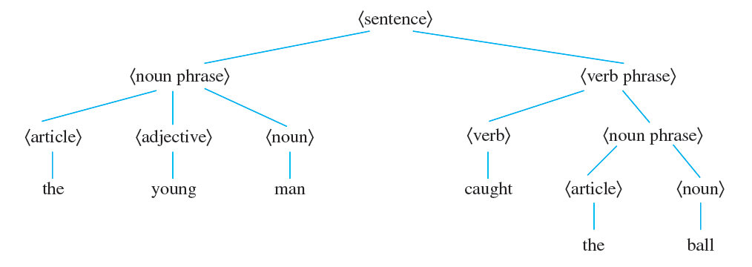
Example 10.4.3 – A Parse Tree
continued
The derivation of the sentence “The young man caught the ball” from the above rules is described by the tree shown below.

Slide 16
Example 10.4.3 – A Parse Tree
continued
In the study of linguistics, syntax refers to the grammatical structure of sentences, and semantics refers to the meanings of words and their interrelations.
A sentence can be syntactically correct but semantically incorrect, as in the nonsensical sentence “The young ball caught the man,” which can be derived from the rules given on the previous slides.
Or a sentence can contain syntactic errors but not semantic ones, as, for instance, when a two-year-old child says, “Me hungry!”

Slide 17
Characterizing Trees

Slide 18
Characterizing Trees
There is a somewhat surprising relation between the number of vertices and the number of edges of a tree.
It turns out that if n is a positive integer, then any tree with n vertices (no matter what its shape) has n − 1 edges.
Perhaps even more surprisingly, a partial converse to this fact is also true—namely, any connected graph with n vertices and n − 1 edges is a tree.

Slide 19
Characterizing Trees
It follows from these facts that if even one new edge (but no new vertex) is added to a tree, the resulting graph must contain a circuit.
Also, from the fact that removing an edge from a circuit does not disconnect a graph, it can be shown that every connected graph has a subgraph that is a tree.
It follows that if n is a positive integer, any graph with n vertices and fewer than n − 1 edges is not connected.

Slide 20
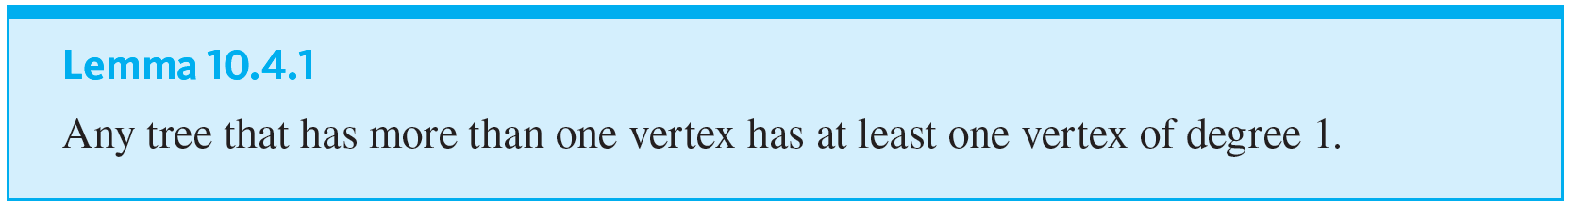
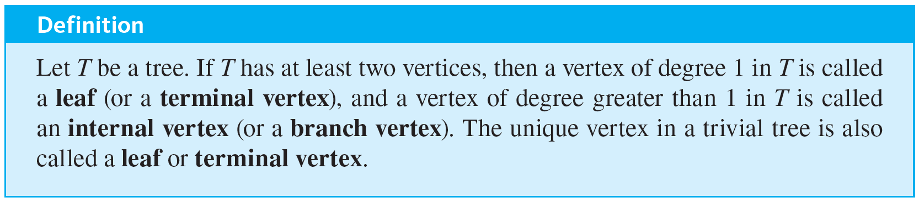
Characterizing Trees
A small but very important fact necessary to derive the first main theorem about trees is that any nontrivial tree must have at least one vertex of degree 1.

Slide 21
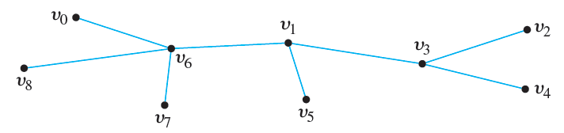
Example 10.4.5 – Leaves and Internal Vertices in Trees
Find all leaves (or terminal vertices) and all internal (or branch) vertices in the following tree:

Slide 22
Example 10.4.5 – Solution
The leaves (or terminal vertices) are v₀, v₂, v₄, v₅, v₇, and v₈. The internal (or branch) vertices are v₆, v₁, and v₃.

Slide 23
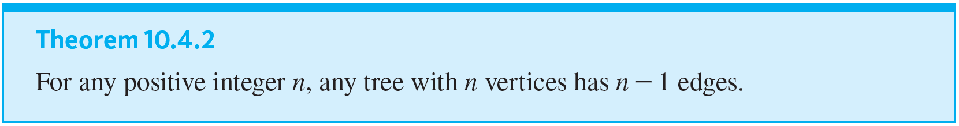
Characterizing Trees

Slide 24
Example 10.4.6 – Determining Whether a Graph Is a Tree
A graph G has ten vertices and twelve edges. Is it a tree?

Slide 25
Example 10.4.6 – Solution
No. By Theorem 10.4.2, any tree with ten vertices has nine edges, not twelve.

Slide 26
Example 10.4.7 – Finding Trees Satisfying Given Conditions
Find all nonisomorphic trees with four vertices.

Slide 27
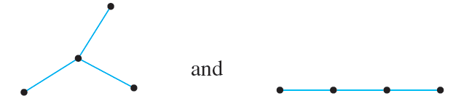
Example 10.4.7 – Solution
By Theorem 10.4.2, any tree with four vertices has three edges. Thus the total degree of a tree with four vertices must be 6. Also, every tree with more than one vertex has at least two vertices of degree 1.
Thus the following combinations of degrees for the vertices are the only ones possible: 1, 1, 1, 3 and 1, 1, 2, 2. There are two nonisomorphic trees corresponding to both of these possibilities, as shown below.

Slide 28
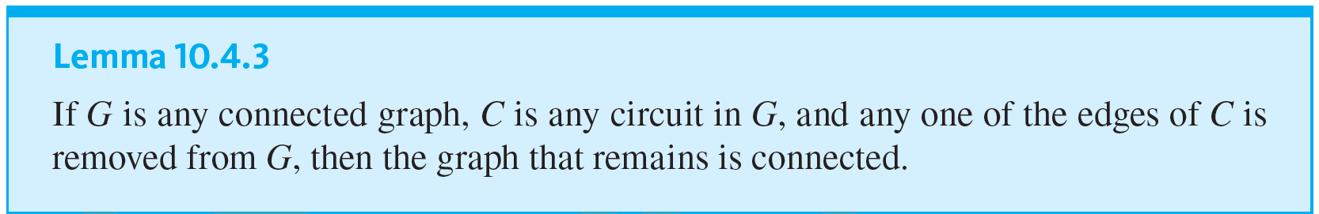
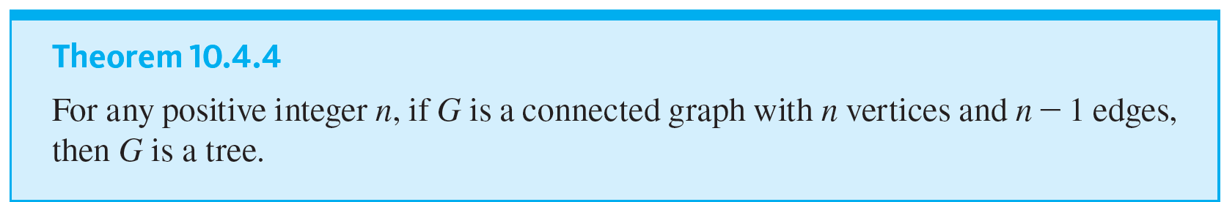
Characterizing Trees

Slide 29
Example 10.4.8 – A Graph with n Vertices and n − 1 Edges That Is Not a Tree
Give an example of a graph with five vertices and four edges that is not a tree.

Slide 30
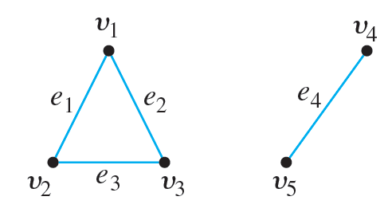
Example 10.4.8 – Solution
By Theorem 10.4.4, such a graph cannot be connected. One example of such an unconnected graph is shown below.

Slide 31
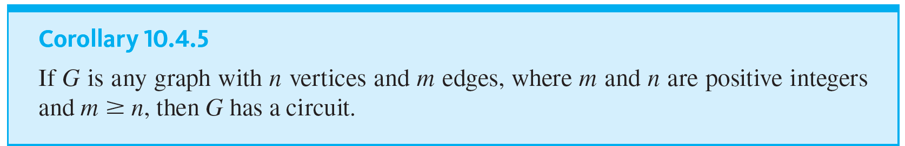
Characterizing Trees

